Slide 1
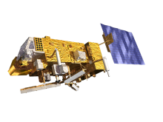
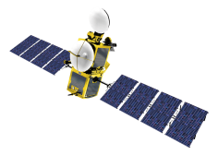
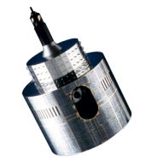
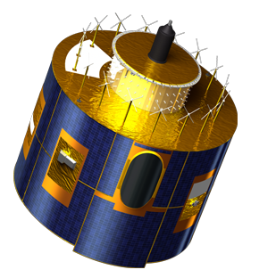
EUMETCast DVB-S2 Operations and Future High Volume Service
Klaus Peter Renner

Slide 2
Introduction
Key components of EUMETCast and System description
EUMETCast Europe Operations Status
HVS Reception Station Requirements
Evolution of EUMETCast
Future Data Services

Slide 3
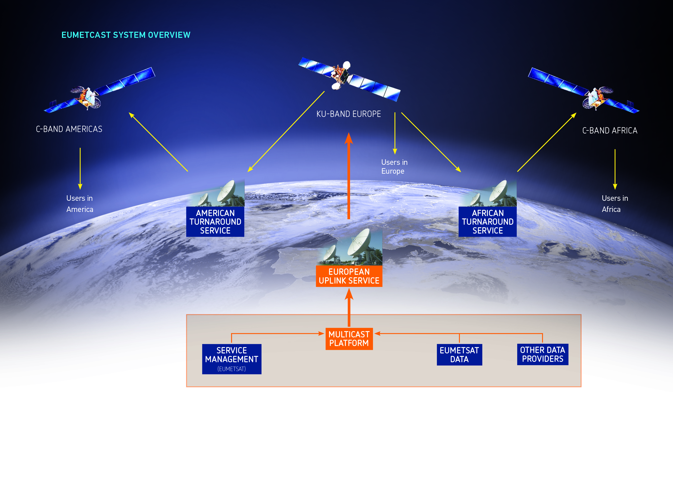
Key components of EUMETCast and System Description

Slide 4
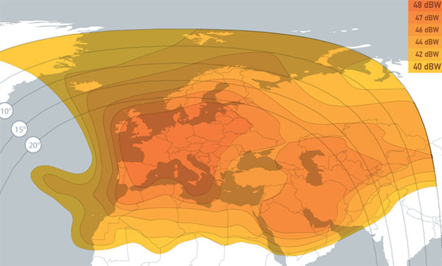
Key components of EUMETCast and System Description
Europe Footprint
EUTELSAT 10A (10 deg East)

Slide 5
Key components - Basic Service
Continuation of the current EUMETCast Europe Service for large User Community;
Limited growth, mainly for low volume data;
On the (currently used) first transponder;
Requires compatible DVB devices;
Recommended antenna sizes: to be selected for an availability of 99.98% (average over a year), see next slides;

Slide 6
Key components - High Volume Service (HVS)
The High Volume Service is optimised for higher data rates up to 80 Mbps per transponder;
Recommended antenna sizes are larger ( by a factor of 1.8) compared to the Basic Service, see next slides;
Basic Service recommended antenna sizes will still be able to receive the High Volume Service, but at a reduced availability, e.g. they will have less rain margin;
Requires compatible DVB devices;
COPERNICUS S3 will be on the High Volume Service

Slide 7
DVB-S2 Parallel Operations Phase
Parallel Phase started on 14 August 2014 with operational start of Basic Service;
Purpose:
Allow users to migrate from DVB-S to DVB-S2;
Migrate C-Band Africa and Americas Service to the DVB-S2 feed;
Migrate operational monitoring to DVB-S2;
Prepare overall system, operations teams and users for the termination of DVB-S.

Slide 8
DVB-S2 Parallel Operations Phase cont.
Achievements:
In September the High Volume service validation was successfully completed and test dissemination resumed;
On 2 December 2014:
C-Band Africa and Americas Service moved to DVB-S2 feed;
operational monitoring of services, daily reception logs and OSSI based on DVB-S2;
DVB-S monitoring reduced to generic service monitoring;
Training completed for termination of DVB-S;
November – December;
Frequent reminders to user about DVB-S termination.

Slide 9
DVB-S2 Operations Phase
Achievements:
Since late 2014;
Frequent enquiries mainly from amateur users, and mainly requesting support for;
antenna alignment;
low price DVB devices;
Relatively few requests around DVB-S switch off time;
Continued support requests since January
(same scope as above).

Slide 10
DVB-S2 Operations Phase cont.
Observations:
During sun co-linearity up to 6 dB drop in link margin;
for 2 to 3 days at maximum interference time loss of lock is possible;
Firmware updates for SR1 and Newtec DVB routers solve low link margin and locking problems.

Slide 11
DVB-S2 Operations Phase cont.

Slide 12
Documentation
TD 15 is updated;
Update of EUMETCast WEB pages is in progress;
Update of the EUMETCast CD is in progress, current status is available for download from the ftp server.

Slide 13
User Experience
Receiver upgrade relatively easy for DVB routers, after a learning curve dealing with multicast networking;
Recently available USB and PCI/PCIE cards provide low price alternative, thanks to persistent driver developers and users BUT: more complicated setup and compatibility problems with old hardware;
Main challenge turned out to be the antenna/LNB alignment;
Pointing;
LNB Skew angle;
LNB focussing (sometimes requires new LNBs).

Slide 14
Further Client Evolution
New client version (2.12) with fixes (java security, etc.) new functionality and better performance currently available as pre-release without installers via EUMETCast, and will be available Q3 2015 as installer versions;
Future evolution of clients depending on the needs, e.g. 64bit versions, other platforms;
New EKUs (eToken 72K) support more modern Linux drivers Existing EKUs remain valid.

Slide 15
HVS Reception Station Requirements – typical design

Slide 16
HVS Reception Station Requirements
Antenna requirements
DVB device requirements
Standalone Reception stations recommended (no virtual machines)
PC requirements
More information:
See TD 15: EUMETCast — Broadcast System for Environmental Data
http://www.eumetsat.int/website/home/Data/DataDelivery/EUMETCast/ReceptionStationSetup/index.html

Slide 17
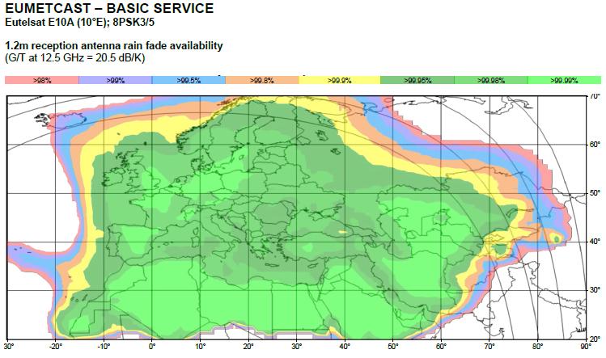
Basic Service - Antenna size plots

Slide 18
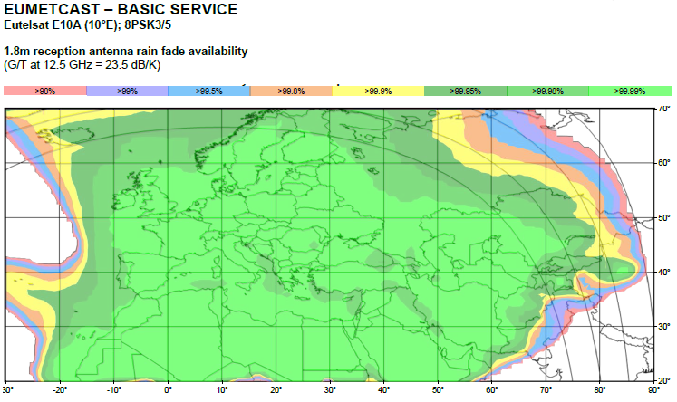
Basic Service - Antenna size plots

Slide 19
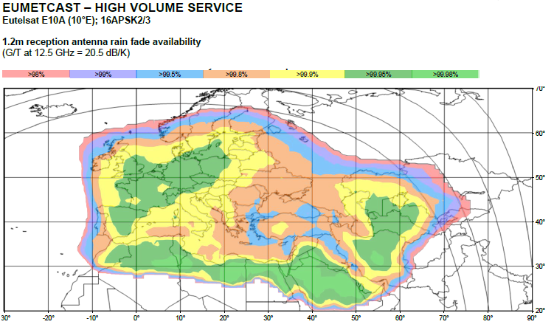
High Volume Service - Antenna size plots

Slide 20
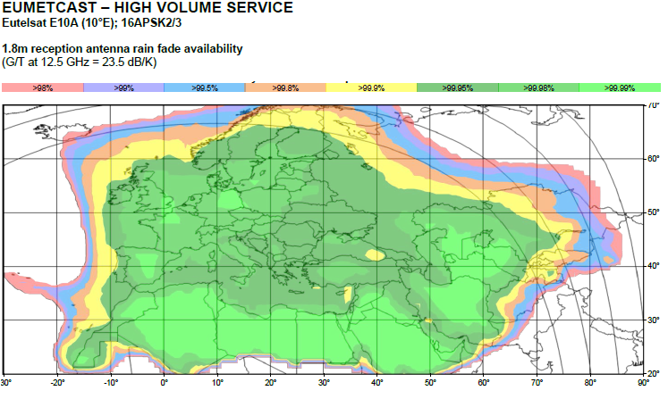
High Volume Service - Antenna size plots

Slide 21
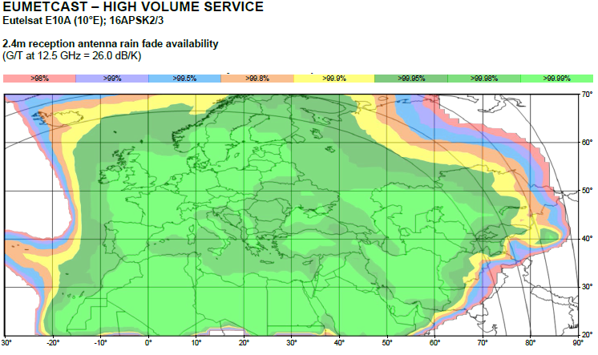
High Volume Service - Antenna size plots

Slide 22
HVS Reception Station Requirements – DVB Devices
Company Name | Model | Type | OS Support | Further information by Company | EUMETCast Setup Information | Used by EUMETSAT
Ayecka | Ayecka SR1 | Router/LAN | All | Ayecka SR1 Satellite Receiver | SR1 Setup Guide (v3C) | Yes
Newtec | MDM6000 (successor of EL940) | Router/LAN | All | Newtec MDM6000 Satellite Modem | MDM6000 Setup Guide (v1C) | Yes
Novra | Novra S300E or S300N | Router/LAN | All | Novra S300E Satellite Receiver | S300 Setup Guide (v2A) | Yes
Omicom | Pro Omicom 16/32 PSK | PCI Card | Windows/Linux | Omicom Pro 16/32 APSK PCI | Omicom Windows Setup Guide (v1C) | Yes
TBS | TBS 6925/6983 | PCIe | Windows, Linux | TBS-6925 TBS-6983 | TBS-6925/6983 Windows Setup Guide (v1D) TBS-5925/6925/5983/6908 Linux Setup Guide (v1B) | Yes
TBS | TBS 6908 | PCIe | Windows, Linux | TBS-6908 | TBS-6908 Windows Setup Guide (v1B) TBS-5925/6925/5983/6908 Linux Setup Guide (v1B) | Yes
TBS | TBS 5925 | USB | Windows, Linux | TBS-5925 Satellite Receiver | TBS-5925 Windows Setup Guide (v1D) TBS-5925/6925/5983/6908 Linux Setup Guide (v1B) | Yes
The following device with STV0903BAC demodulator chip support only 8PSK MODCODs
TechniSat | Skystar 2 HD | PCIe | Windows | Skystar 2 eXpress HD | SKYSTAR 2 HD PCIe WINDOWS BS Setup Guide (v1B) | Yes. Note Basic Service reception only

Slide 23
HVS Reception Station Requirements
EKU
TCP/IP stack
DVB
NIC
router
Tellicast
client
file
DVB
database
card
Key to symbols
Disk access
Multicast, UDP
Samba
Log events
logs
received data
processed data
server
FTP data transfer
File fragments
USB transfers
Data
L
-
band RF
Logfile processing
Data processing
Data dispatch
transfers
Data to external nodes
RAM disk
Hard disk partition
NIC
Software process
Log messages
Log events transfer
Network/DVB card
Reception station
(with driver, software)

Slide 24
HVS Reception Station Requirements
Critical elements:
(EUMETCast is a real time system)
Networking optimised for multicast
Storage speed
I/O performance and large enough disk cache
SSD disks
CPU is less critical (state of the art PC CPU is sufficient)

Slide 25
HVS Data flow requirements
For one satellite (S3A):
Total sustained data rate between 32 and 35 Mbps
One large channel ~ 30 Mbps, with big files 900 MB, every 3 minutes
Up to 5 more channels with a total of 5 Mbps
Challenge:
Receive sustained bitrate and write it fast enough to disk, without CPU going into waiting state because of heavy disk I/O activity

Slide 26
Reception test results
Fast channel sensitive to activities in network elements (switches, routers) -> packet losses
Tellicast client 2.12.1 or later required
RAM > 3 GB for increased disk cache
Cache tuning can reduce/avoid packet losses
Fast disks (SAS drives) achieve best results
SSD disks will be tested next
Running BS and HVS still possible on single station without losses

Slide 27
Evolution of EUMETCast – Multi-Transponder

Slide 28
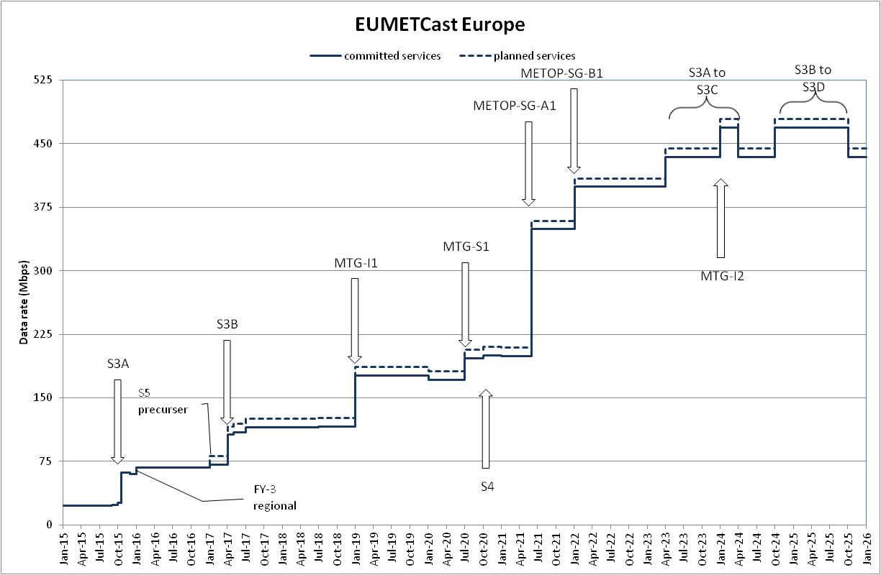
Future Data Services

